Slide 1
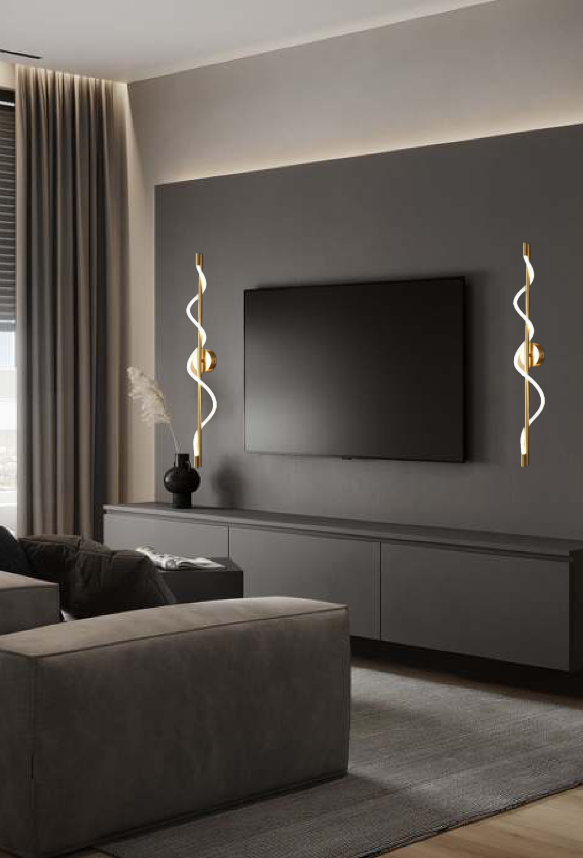
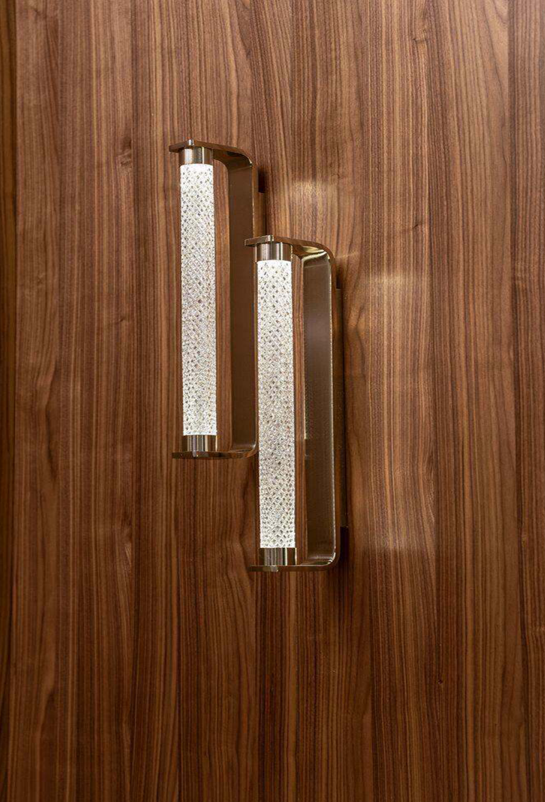
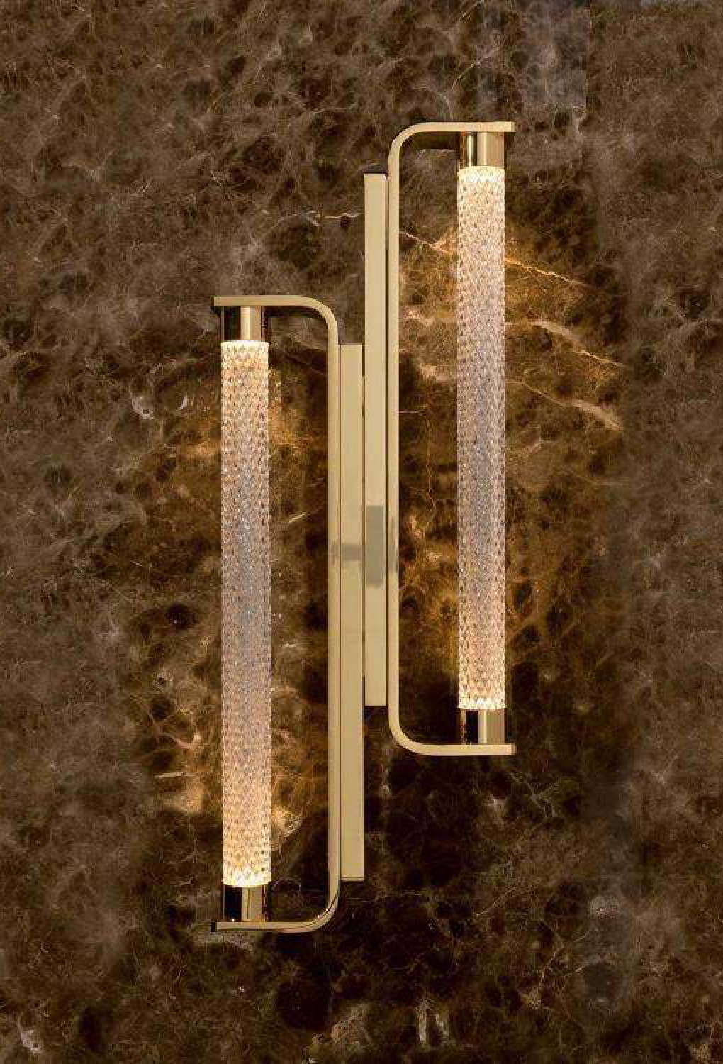
Light House Metal+Silicon Finished Brass Finished Wall Light
Light House Metal+ Crystal Finished French Gold Finished Wall Light
Light House Metal+ Crystal Finished French Gold Finished Wall Light
Handle: NE296_01
Handle: MDQM3116
Handle: MDQM3117
Material: Metal+Silicon
Material: Metal+ Crystal
Material: Metal+ Crystal
Finish: Brass
Finish: French Gold
Finish: French Gold
Price: 7360.0
Price: 7475.0
Price: 10925.0

Slide 2
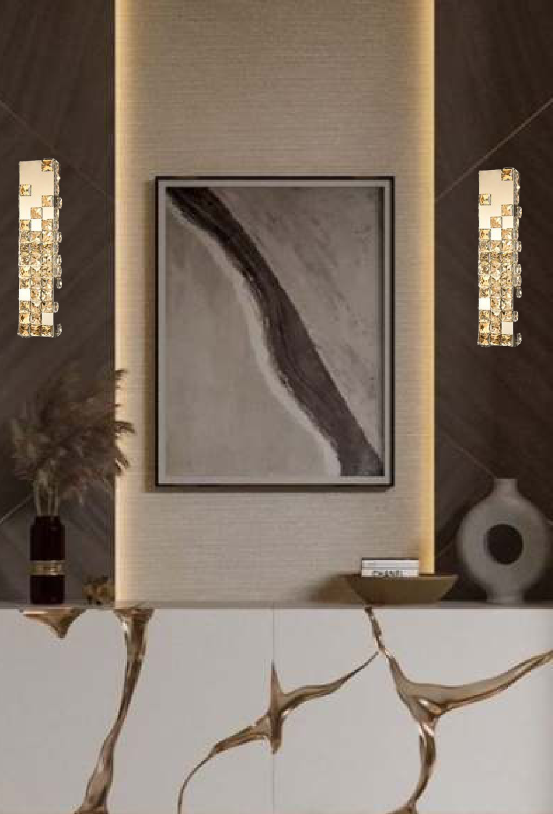
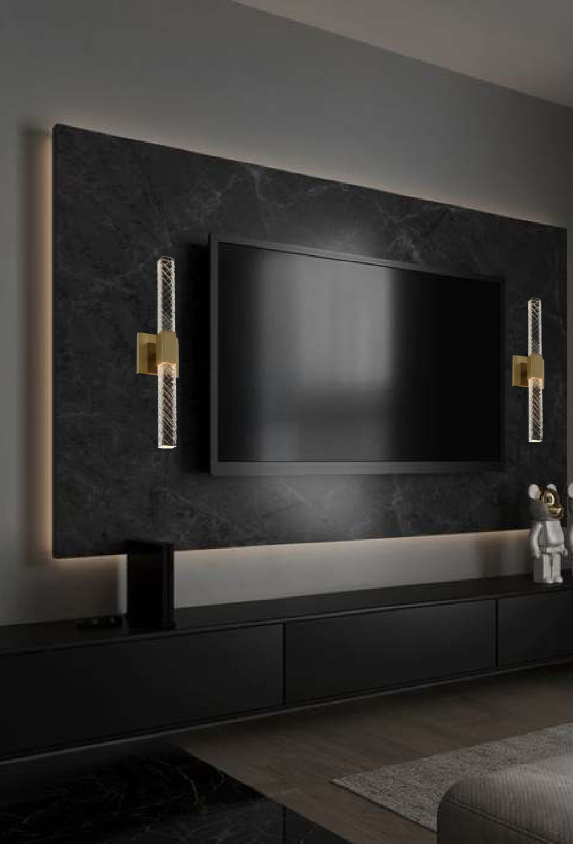
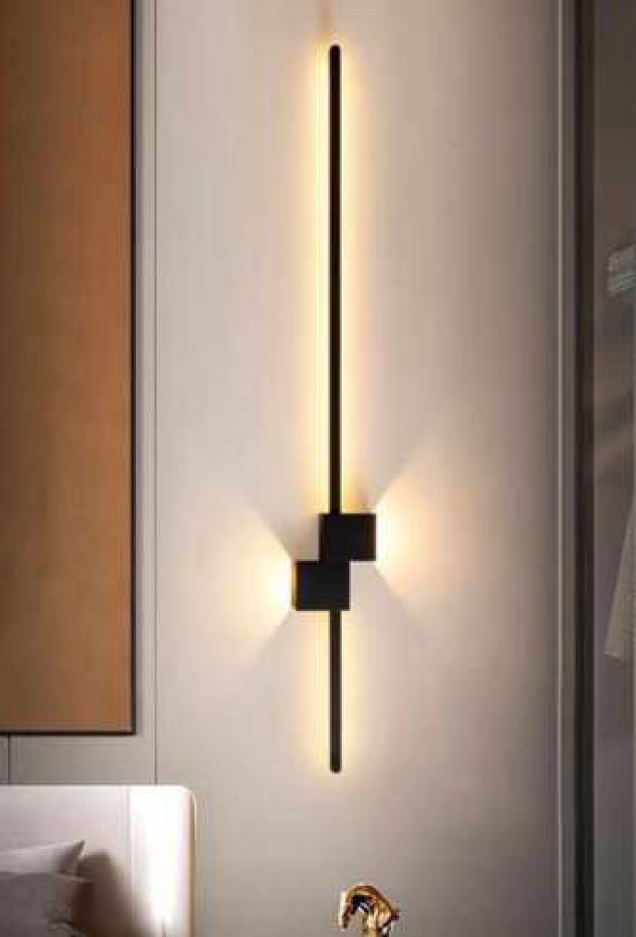
Light House Ss+ Crystal Finished Ti Gold Finished Wall Light
Light House Metal + Acrylic Finished Brass Finished Wall Light
Light House Metal Finished Black Finished Wall Light
Handle: MD3417_C
Handle: EC3265
Handle: MDXM3114
Material: Ss+ Crystal
Material: Metal + Acrylic
Material: Metal
Finish: Ti Gold
Finish: Brass
Finish: Black
Price: 13800.0
Price: 10925.0
Price: 5865.0

Slide 3
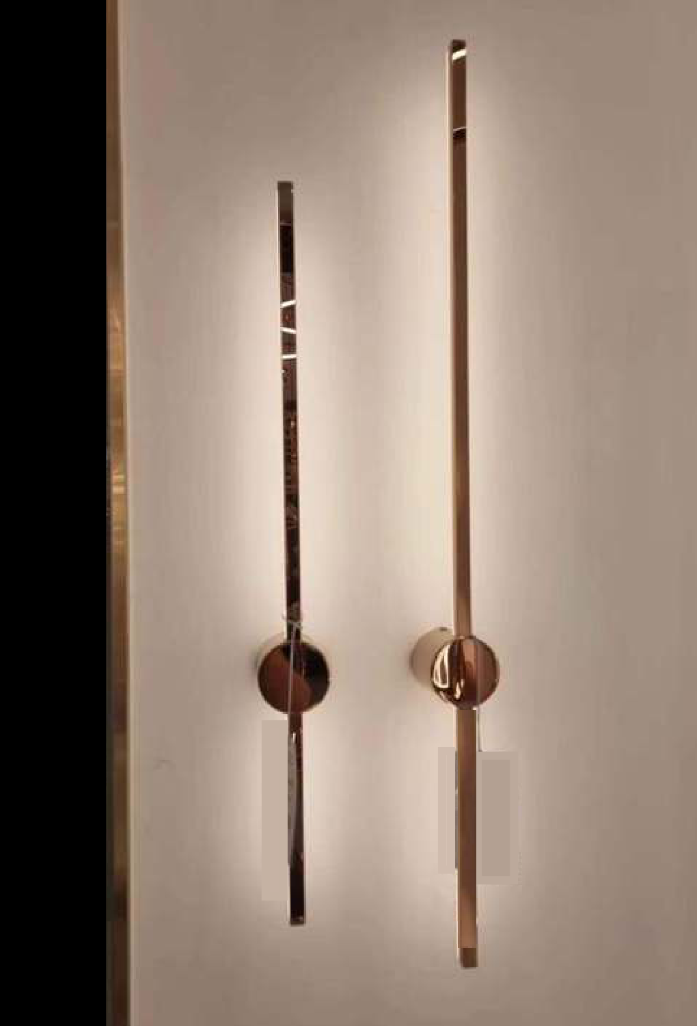
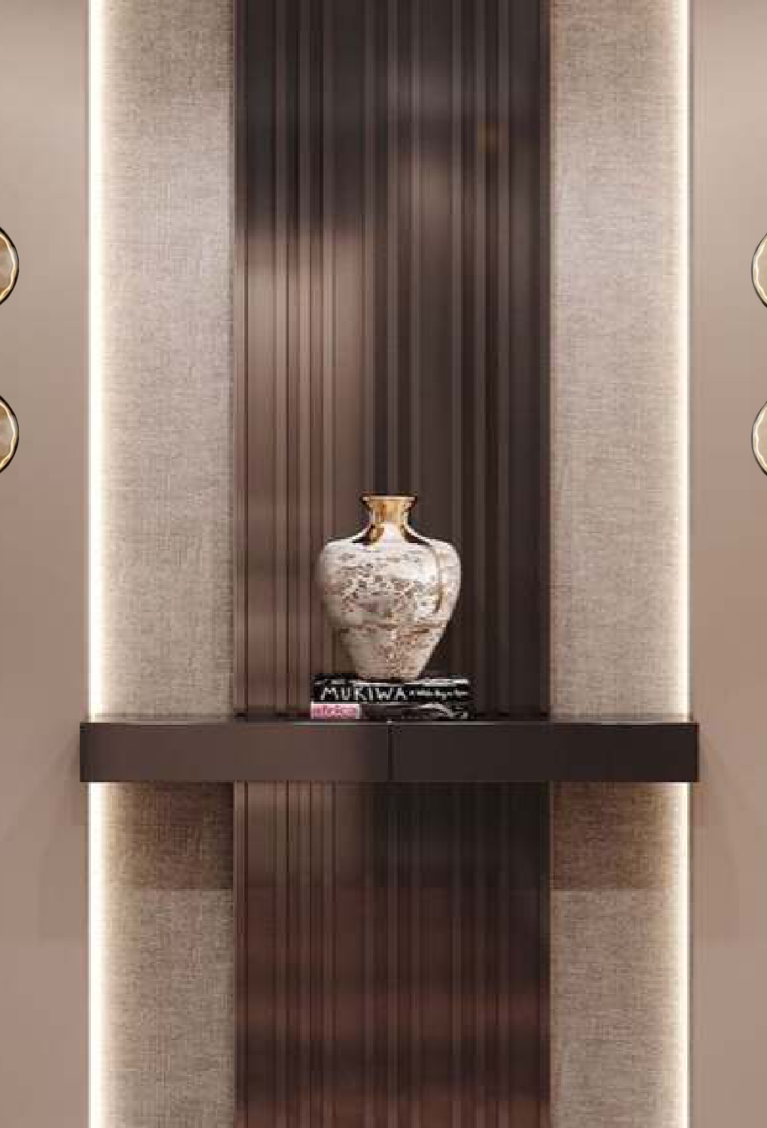
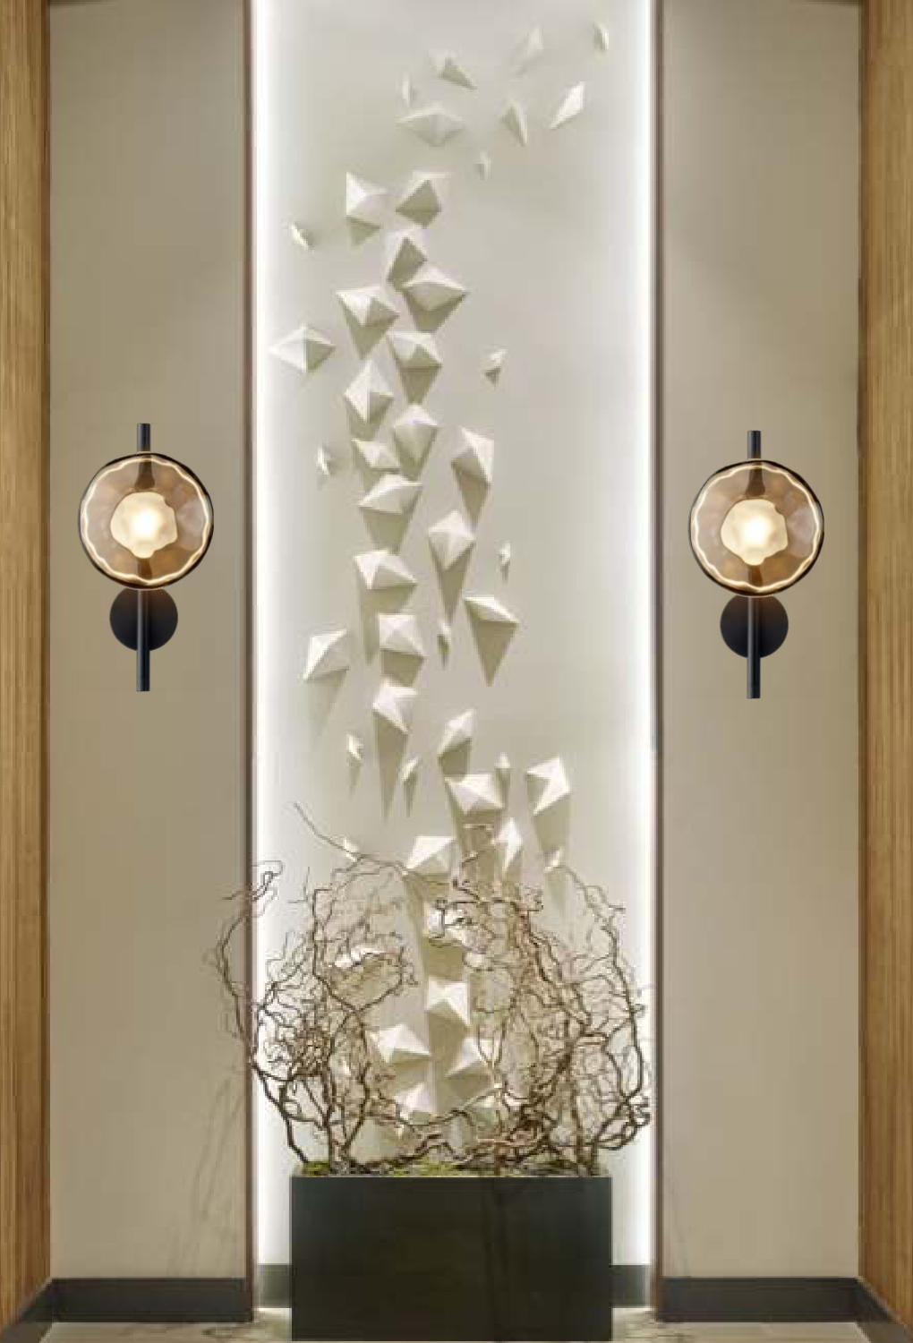
Light House Metal Finished Rosegold Finished Wall Light
Light House Metal + Glass Finished Black +Amber Finished Wall Light
Light House Metal + Glass Finished Black +Amber Finished Wall Light
Handle: MDXM2113_711_911
Handle: NC0134
Handle: NC0133
Material: Metal
Material: Metal + Glass
Material: Metal + Glass
Finish: Rosegold
Finish: Black +Amber
Finish: Black +Amber
Price: 6785.0
Price: 12075.0
Price: 6037.5

